Slide 1
Competitive Programming
19 July 2024

Slide 2

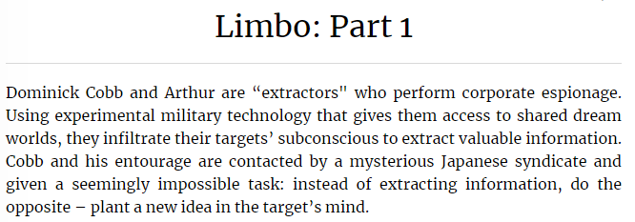
Practice – Math I
Kattis: Limbo: Part 1
Link: https://open.kattis.com/problems/limbo1

Slide 3
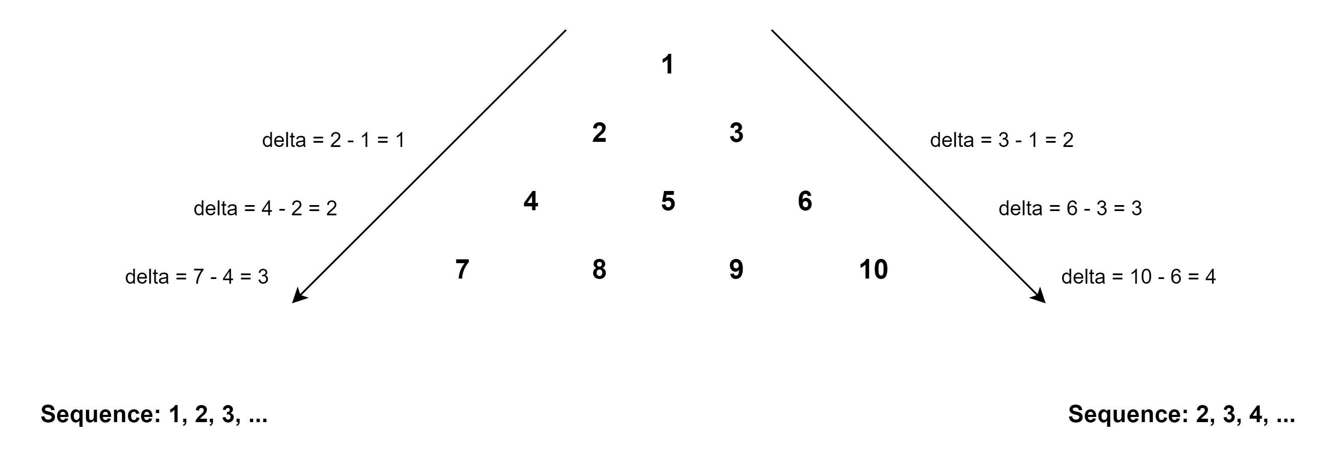
Practice – Math - Limbo: Part 1
Observation

Slide 4
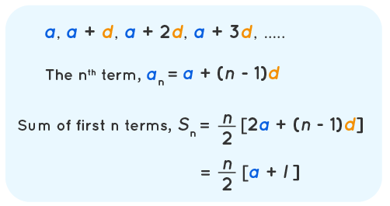
Practice – Math - Limbo: Part 1
Math solution based on arithmetic progression

Slide 5
Practice – Math - Limbo: Part 1
Math solution:
To left (where l is an input, n = l):
a1 = 1;
an = a1 + (n – 1) * 1 = a1 + (l – 1);
Sn = n * (a1 + an) / 2;
After moving left: result = 1 + Sn
To right (where r is an input, n = r):
a1 = 2 + l, we go left first – add l as offset
an = a1 + (n – 1) * 1 = a1 + (r – 1);
Sn = n * (a1 + an) / 2;
After moving right: result = result + Sn;

Slide 6
Practice – Math – Implement the Solution
Kattis: Limbo: Part 1
Link: https://open.kattis.com/problems/limbo1
Implement the Solution

Slide 7
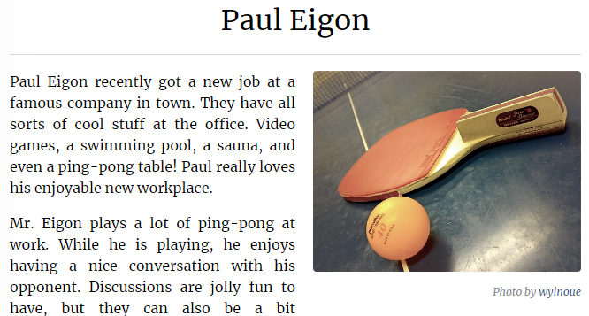
Practice – Math II - Paul Eigon
Kattis: Paul Eigon
Link: https://open.kattis.com/problems/pauleigon

Slide 8
Practice – Math II - Paul Eigon
Observation
We know turn size, so just to check whose turn it is now after dividing:
cur_switch_player_counter = (p + q) / n
if cur_switch_player_counter % 2 == 0, then – Paul
Otherwise – Opponent

Slide 9
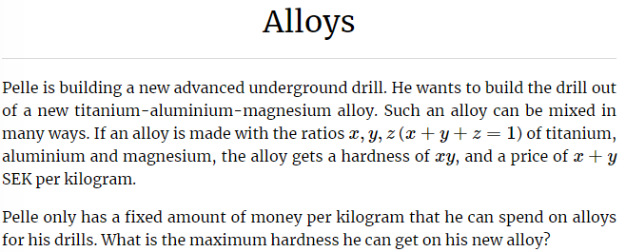
Practice – Math III - Alloys
Kattis: Alloys
Link: https://open.kattis.com/problems/alloys

Slide 10
Practice – Math III - Alloys
Observation
x + y + z = 1,
so (x + y) <= 1 always!
max(x * y), it can be maximized only when x == y, so x = y = c / 2.
Make sure that if c > 1, then c = 1, since x + y + z = c/2 + c/2 + z = 1.
Solution:
c = (input <= 1) ? input : 1;
x = y = c / 2;
xy = x * y – output of the solution

Slide 11
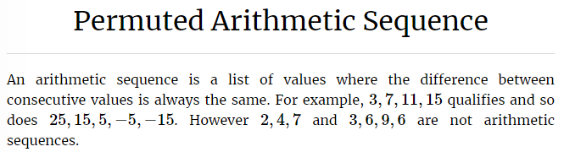
Practice – Math IV - Permuted Arithmetic Sequence
Kattis: Permuted Arithmetic Sequence
Link: https://open.kattis.com/problems/permutedarithmeticsequence

Slide 12
Practice – Math IV - Permuted Arithmetic Sequence
Check if the sequence is sorted and how sorted.
Check if d between adjacent values in the sequence are the same.
If yes – this is arithmetic progression.
Otherwise – non arithmetic progression.

Slide 13
Practice – Math IV - Permuted Arithmetic Sequence
Kattis: Permuted Arithmetic Sequence
Link: https://open.kattis.com/problems/permutedarithmeticsequence
Implement the Solution

Slide 14
Homework Overview
Kattis: How many zeros?
Link to the task: Link
Link to the solution: Link

